Slide 1

Data Structures And Algorithm
One and Two Dimensional Arrays
Lab #1

Slide 2
ARRAY
An array stores a fixed-size sequential collection of elements of the same type.
An array is used to store a collection of data, but it is often more useful to think of an array as a collection of variables of the same type stored at contiguous memory locations.
Instead of declaring individual variables, such as number0, number1, ..., and number99, you declare one array variable such as numbers and use numbers[0], numbers[1], and ..., numbers[99] to represent individual variables.

Slide 3
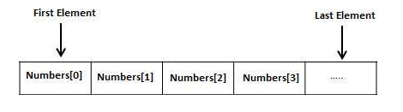
ARRAYS
A specific element in an array is accessed by an index.
All arrays consist of contiguous memory locations. The lowest address corresponds to the first element and the highest address to the last element.

Slide 4
Declaring Arrays
To declare an array in C#, you can use the following syntax
datatype[] arrayName;
where,
datatype is used to specify the type of elements in the array.
[ ] specifies the rank of the array. The rank specifies the size of the array.
arrayName specifies the name of the array.
For example,
double[] balance;

Slide 5
Initializing an Array
Declaring an array does not initialize the array in the memory. When the array variable is initialized, you can assign values to the array.
Array is a reference type, so you need to use the new keyword to create an instance of the array. For example,
double[] balance = new double[10];

Slide 6
Assigning Values to an Array
You can assign values to individual array elements, by using the index number, like −
double[] balance = new double[10];
balance[0] = 4500.0;
You can assign values to the array at the time of declaration, as shown
double[] balance = { 2340.0, 4523.69, 3421.0};
You can also create and initialize an array, as
int [] marks = new int[5] { 99, 98, 92, 97, 95};
You may also omit the size of the array, as shown
int [] marks = new int[] { 99, 98, 92, 97, 95};

Slide 7
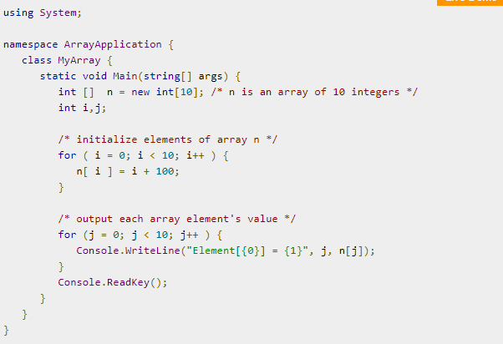
EXAMPLE
The following example, demonstrates the above-mentioned concepts declaration, assignment, and accessing arrays

Slide 8
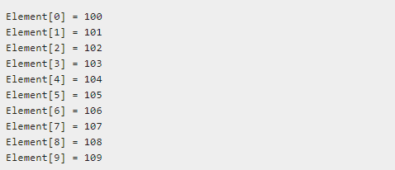
OUTPUT
When the above code is compiled and executed, it produces the following result

Slide 9
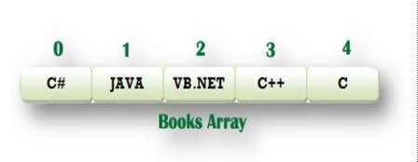
1D Array
The one dimensional array or single dimensional array in C# is the simplest type of array that contains only one row for storing data. It has single set of square bracket (“[]”).
To declare single dimensional array in C#
string[] Books = new string[5];

Slide 10
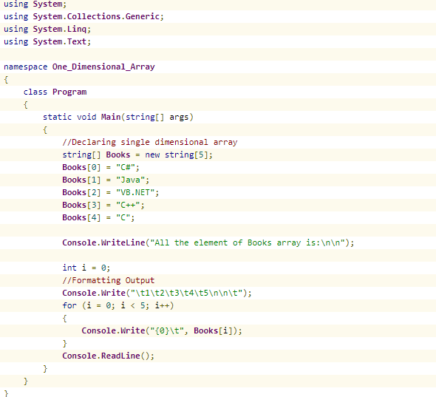
Example 1D Array

Slide 11
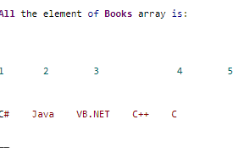
OUTPUT:

Slide 12
2D Arrays
The simplest form of the multidimensional array is the 2-dimensional array. A 2-dimensional array is a list of one-dimensional arrays.
A 2-dimensional array can be thought of as a table, which has x number of rows and y number of columns. Following is a 2-dimensional array, which contains 3 rows and 4 columns.
Thus, every element in the array a is identified by an element name of the form a[ i , j ], where a is the name of the array, and i and j are the subscripts that uniquely identify each element in array a.

Slide 13
Initializing Two-Dimensional Arrays
Multidimensional arrays may be initialized by specifying bracketed values for each row. The Following array is with 3 rows and each row has 4 columns.
int [,] a = new int [3,4] {
{0, 1, 2, 3} , /* initializers for row indexed by 0 */
{4, 5, 6, 7} , /* initializers for row indexed by 1 */
{8, 9, 10, 11} /* initializers for row indexed by 2 */
};

Slide 14
Accessing Two-Dimensional Array Elements
An element in 2-dimensional array is accessed by using the subscripts. That is, row index and column index of the array. For example,
int val = a[2,3];

Slide 15
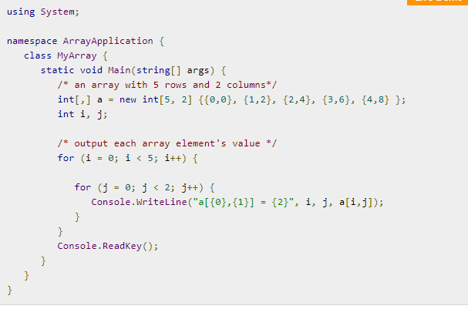
2D Array Example

Slide 16
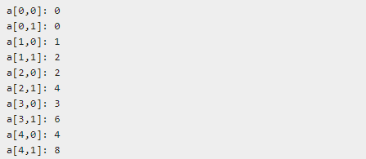
OUTPUT:

Slide 17
Lab tasks
1D ARRAYS
TASK1: Create an array A of length 10 of integers. Values ranging from 1 to 50.
1. Find all pair of elements whose sum is 25.
2. Find the number of elements of A which are even, and the number of elements of A which are odd.
3. Write a procedure which finds the average of the value of A.

Slide 18
Task
TASK 2: Write a C# program that utilizes a 1D array to implement a simple inventory management system
1: Inventory Setup
Create an array to store inventory items and initialize the item count.
2: Main Menu Loop
Implement the main menu loop for the inventory management system. This loop will repeatedly display options to the user until they choose to exit.
3: Add Item
Implement the functionality to add an item to the inventory. Ask the user for the name of the item to add, and add it to the inventory array.
4: Remove Item
Implement the functionality to remove an item from the inventory. Ask the user for the name of the item to remove, and remove it from the inventory array if found.
5. Search Item
Implement the functionality to search for an item in the inventory. Ask the user for the name of the item to search for and display whether it's in the inventory or not.

Slide 19
Task
6: Display Inventory
Implement the functionality to display the current items in the inventory.
7: Exit Program
Implement the functionality to exit the inventory management system when the user chooses to exit.

Slide 20
2D ARRAYS
1. Write a program which input 2 matrix of user defined rows and columns and perform following operation
a. Display/Print as a Matrix
b. Addition of Matrix
c. Subtraction of Matrix
d. matrix multiplication
e. Determinant
f. Inverse

